Slide 1
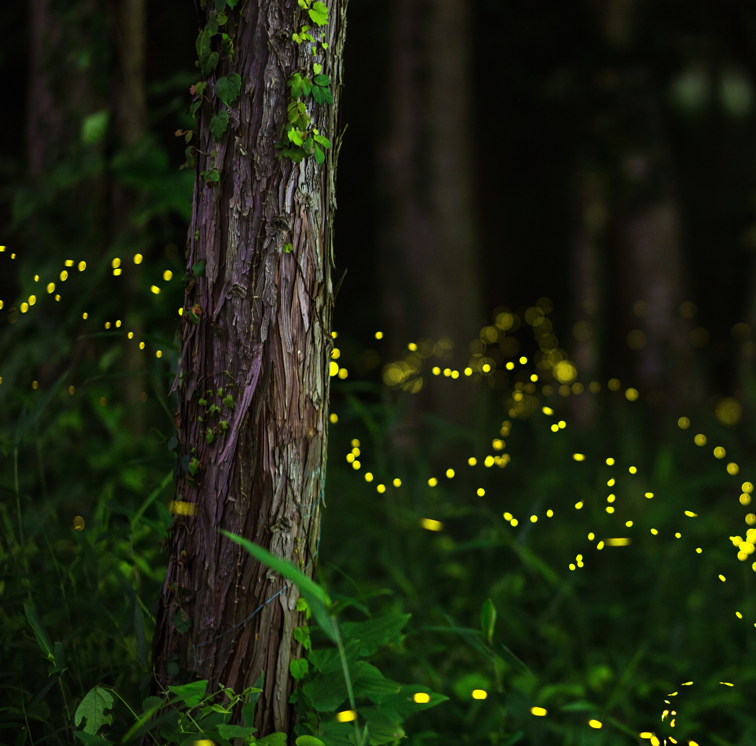
Plant Monitor
Chroma Lumiere

Slide 2
How it began
Our lecture on our plant monitoring system, instantly brought to my mind famous talking plants, such as Audrey from “Little Shop of Horrors” and Super Mario's Piranha plant.
What other ways could a plant say feed me!
I instantly thought of way of how plants could communicate but not necessarily sending a message to app but providing them with another means of communication.

Slide 3
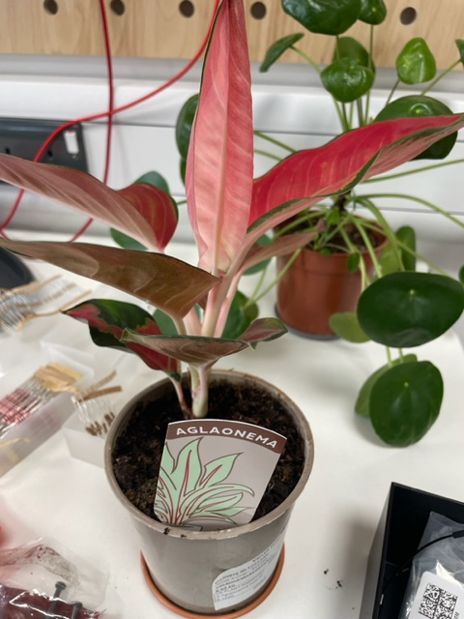
Red-star Aglaonema
The plant I chose was based on light sensitivity and would give me fluctuating variables that should regularly change the LEDs in the plant pot.

Slide 4

I had various design concepts based on the nervous system response of squid and octopuses using the process chromatophores and what fireflies use in bioluminescence but in a cruder form using an led light that could change the colour of the glow on a plant pot. I named this plant pot “Chroma Lumiere” the Latin word for colour and the French word for light.

Slide 5
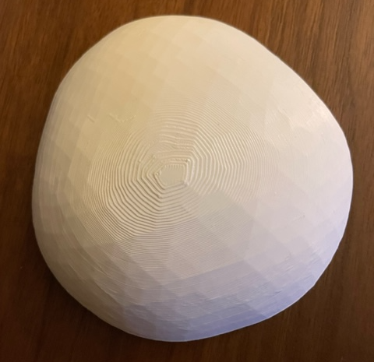
3D Printing
I headed over to B-made to get a opaque plant pot 3d printed with very few layers to allow for the LED light to emit a soft glow.

Slide 6
Then came the code…
Following the instructions to setup the feather Huzzah was straight forward to a point.
I found that the Wi-Fi was a significant factor that worked against my own time to reflect and fully understand the instructions given.
The theory of topic and writing to the Mqtt client was being put in practice.
Although when to joining or splitting the code wasn’t as clear to me.
I obtained new knowledge setting up Telegraf and Grafana although more time would have been ideal in grasping how to link the software and our plant monitors.

Slide 7
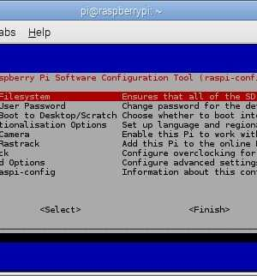
Raspi-config is your friend.
Setting up the Raspberry pi was successful until I left Casa…although if I had known of Raspberry config, I wouldn’t have dedicated so much time in trying to get it fixed and wouldn’t have panicked.

Slide 8
Further reading
On further reading into Raspi con-fig, I think the additional steps that this website provided would have been a great supplementary aid in this case : Three methods to configure Raspberry Pi . All information will be added to my Git repository.

Slide 9
Conclusion

